Slide 1
Microservices Architecture
Course Plan

Slide 2

Microservices Architecture
Microservices
Microservices
Microservices
Microservices
Microservices
Microservices
Monolithic

Slide 4
Monolith Applications

Slide 5
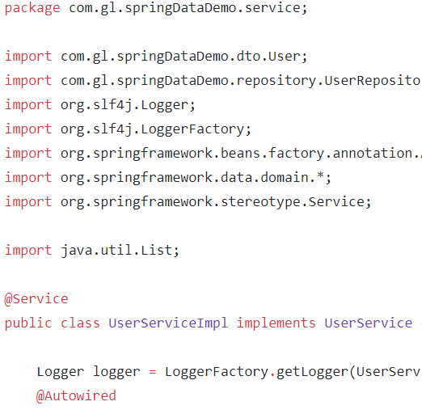

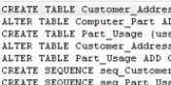
Online Shopping Portal
C
O
N
T
R
O
L
E
R
L
A
Y
E
R
D
A
O
L
A
Y
E
R
Product Management
Database
Account Management
Payment Management
Login Management
Order Management

Slide 6
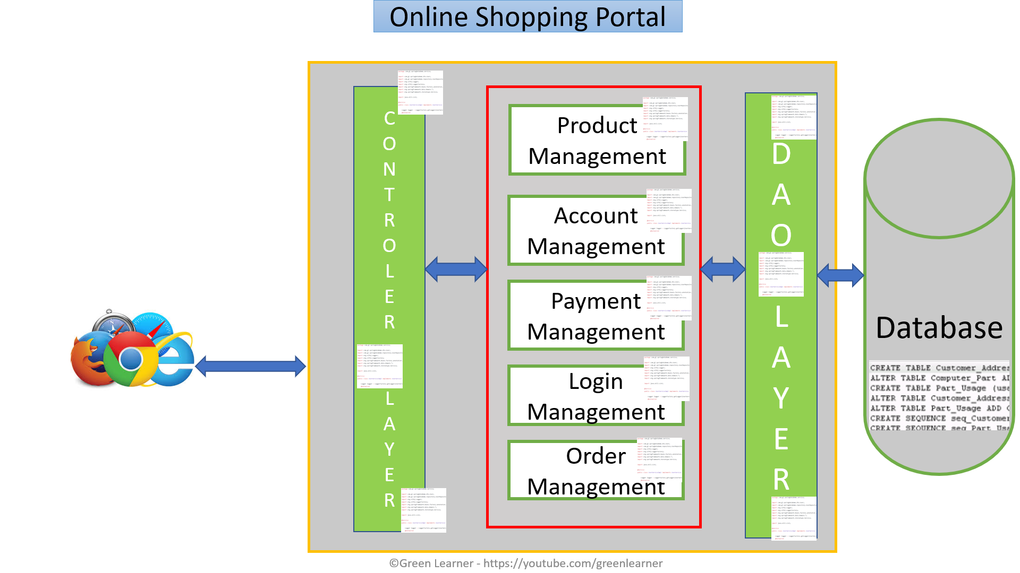
Monolith – positive aspects
Simple testing
Quick deployment
Easy to develop

Slide 7
Monolith – positive aspects
Easy to scale by having multiple copy of same application(horizontal scaling)
Less technicality
Better for small scale apps

Slide 8
By the time company grows
so the application

Slide 9


Online Shopping Portal
C
O
N
T
R
O
L
E
R
L
A
Y
E
R
D
A
O
L
A
Y
E
R
Product Management
Database
Account Management
Payment Management
Login Management
Order Management

Slide 10
Monolith – Challenges
Limitation in size
Complexity grows with time
Long time to release new features
Even small change in one module needs redeployment of whole application
More time to send the fix for production bug

Slide 11
Monolith – Challenges
High Dependency on few human resources
Hiring new team and making them understand whole application is tough
Stuck in one technology
Single point failure

Slide 12
Monolith – Challenges
Continuous deployment is difficult
Difficult to scale when we have large code base
High coupling between modules
Reliability and availability problem

Slide 13
What’s the solution then??

Slide 14
Microservices

Slide 15
Online Shopping Portal
Database
G
A
T
E
W
A
Y
Product Management
Database
Order Management
Database
Account Management
Database
Payment Management
Login Management
Database

Slide 16
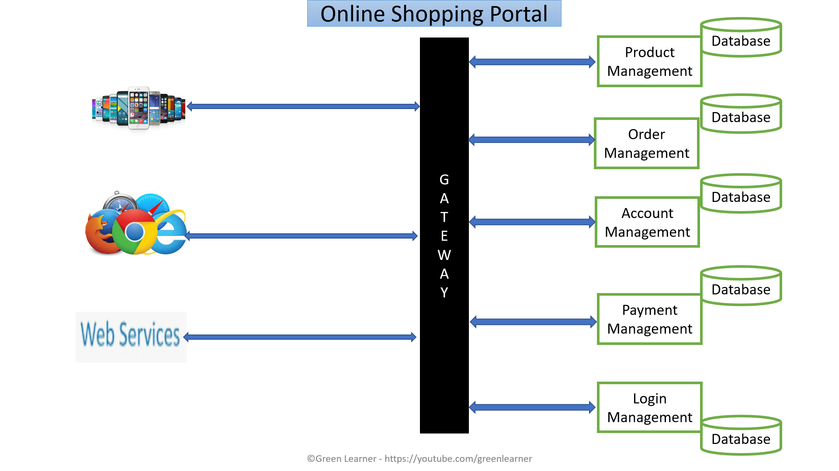
Microservices : Positive aspects
Domain expertise
Easy and quick to scale – on demand
Isolated decision making
Self Organisation
Quick response to change
Increase uptime
Can experiment with any tech
Loose coupling
Service reusability
Agile, SCRUM
Best for large scale apps

Slide 17
Microservices :Challenges
Additional complexity with distributed systems
Deployment complexity
Monitoring complexity
Increased resource consumption
Communication among services is challenging
Testing each service is also a challenge
Maintaining transnationality among services

Slide 18
Fundamental problems with Monoliths which can’t be solved without changing the architecture??
Response to change – bug fix or adding new feature
On demand scaling
Flexibility
Adopting new technologies for better performance

Slide 19
What next??
Microservices : Design principles

Slide 20
Microservices Architecture
Microservices: design principles

Slide 21



Why?? Is it mandatory to go through these?

Slide 22
What are Design Principles??
Independent/ Autonomous
Resilient/ Fault Tolerant/ Design For Failure
Observable
Discoverable
Domain Driven
High Cohesion
Single Source Of Truth
Decentralization

Slide 23
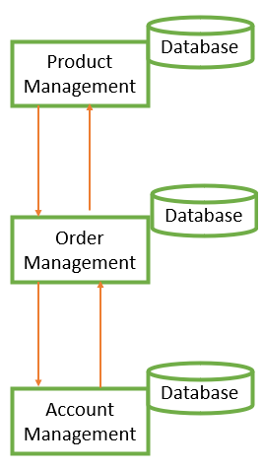
Small team size
Parallel development
Clear contracts
Individually deployable
Independent/ Autonomous

Slide 24
Avoid single point of failure
Avoid cascading failure
Consider failure as events and analyse it properly
Resilient /
Fault Tolerant / Design For Failure

Slide 25
Centralized monitoring
Centralized logging
Health check system
Observable

Slide 26
All services should be registered at one place
It makes client’s life easy when looking for specific service
Discoverable

Slide 27
Focussed on business
Focussed on core domain
Focus on Domain logic
Domain Driven

Slide 28
Database for each service
Choice of database depends on the nature of particular service
Decentralization

Slide 29
Do one thing only
SRP
A business function
A business domain
Easy to take new similar feature
Why
Scalability
Availability
Database
Product Management
High Cohesion
Database
Order Management
Database
Account Management

Slide 30
There should be only one source to get the complete information
This helps in avoiding the duplicity
Single Source Of Truth

Slide 31
What next??
Microservices : Design Patterns

Slide 32
Microservices Architecture
Microservices: Design Patterns

Slide 33
Why??
We need our services to be highly
Available
Scalable
Resilient to failures
Efficient
Design patterns help in solving the specific microservice architecture challenge
Design patterns help in reducing risk of failure in microservices

Slide 34
What are those patterns??
Decomposition
Database
Communication Among services
Integration
Observability
Cross-cutting concern
Deployment

Slide 35
Decomposition patterns
Database patterns
By business capabilities
By subdomain
Strangler pattern
Sidecar pattern / Service mesh
Database per service
Shared Database
CQRS
SAGA
Event Sourcing

Slide 36
Communication Among services
Synchronous
Async - event/messag based
Communication Medium
HTTP REST - xml/json
Graphql
gRPC
Integration patterns
API gateway
Aggregator pattern
Chained Pattern
Branch pattern
client side UI composition patterns

Slide 37
Deployment patterns
Multiple service instances per host
Service instance per host
Service instance per VM
Service instance per Container
Server less
Blue green
Canary

Slide 38
Observability
Log aggregation
Performance metrics
Distributed tracing
health check
Cross Cutting Concern Patterns
external configuration
service discovery pattern
circuit breaker pattern

Slide 39
What next??
Decomposition Pattern : By Business Domain and subdomain

Slide 40
Microservices Architecture
Decomposition Pattern : By Business Domain & Sub Domain

Slide 41
There are 2 kinds of project under microservices
Monolithic to Microservices – Brown Field Projects
Microservices in nature from scratch – Green Field Projects

Slide 42




Microservice – Micro + Service
How Micro? How Small?

Slide 43
How to decide the size of microservice??
Business functionality

Slide 44
How to decide the size of microservice??
Order Management
Placing order
Order tracking
Invoice generation
God Classes
Shared among different modules
Sub domain
Domain Driven Design
Bounded context

Slide 45
What next??
Decomposition Pattern : Strangler

Slide 46
Microservices Architecture
Decomposition Pattern : Strangler

Slide 47
What is Strangler Pattern?
The Strangler Pattern is a popular design pattern to incrementally transform your Monolith application into Microservices by replacing a particular functionality with a new service. Once the new functionality is ready – the old component is strangled, the new service is put into use & the old component is decommissioned all together.

Slide 48
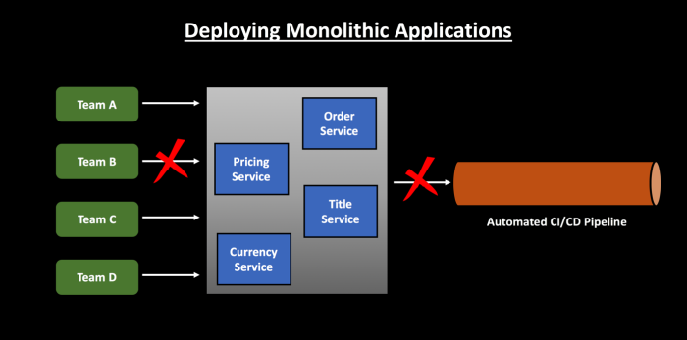
Use Case

Slide 49
Strangler Pattern reduces the above risk. Instead of rewriting the entire application, you replace the functionality step by step. Business value on new functionality is provided much quicker. If you follow Single Responsibility Principle and write loosely coupled code, it makes future refactoring work very simple.

Slide 50
Account Management
Product Management
Product Management
Account Management
Route
Product Management

Slide 51
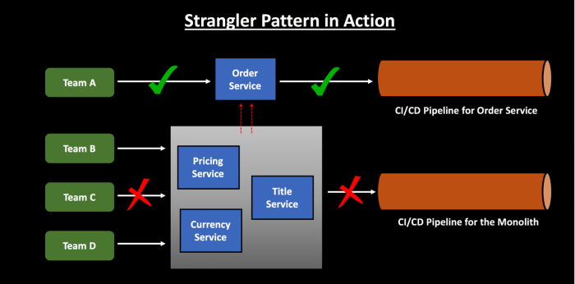

Slide 52
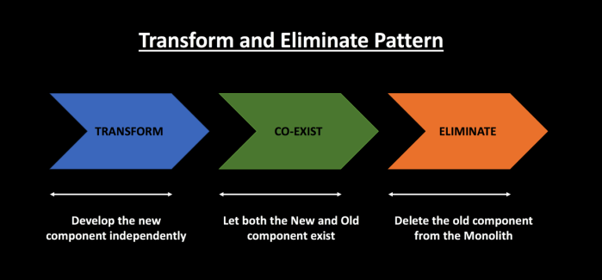

Slide 53
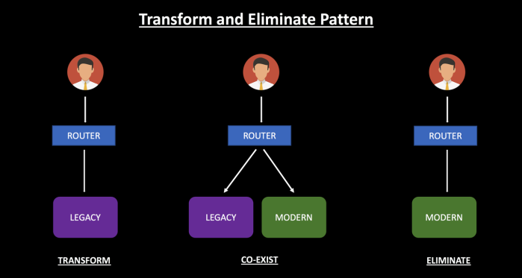

Slide 54
How do you select which components to strangle/refactor first?
If you are following Strangler Pattern for the first time and are new to this design pattern, playing safe and selecting a simple component is not a bad option. This will ensure that you gather practical knowledge and acclimatize yourself about the challenges & best practices before strangling a complex component.
If there is a component which has good test coverage and less technical debt associated with it, starting with this component can give Teams lot of confidence during the migration process.
If there are components which are better suited for Cloud and have scalability requirements, then start with that particular component.
If there is a component which has frequent Business requirements and hence needs to be deployed lot more regularly, you can start with that component. This will ensure that you don’t have to redeploy the entire monolithic application regularly. Breaking up into a separate process will allow you to independently scale and deploy the application.

Slide 55
Transform
Co-Exist
Eliminate

Slide 56
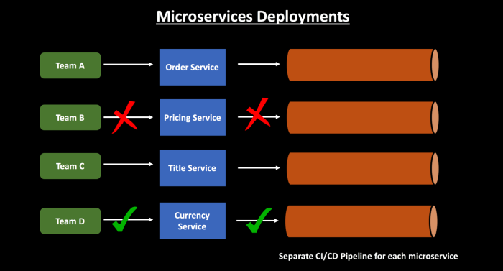

Slide 57

Strangler fig

Slide 58
What next??
Decomposition Pattern : Sidecar/ Service-Mesh

Slide 59
Microservices Architecture
MICROSERVICES DESIGN PATTERNS
Decomposition Pattern : Sidecar/Sidekick Pattern

Slide 60
Common feature to take care for each service
Logging
Failure Isolation
Monitoring
Configuration
Proxy to remote service
etc..

Slide 61
Order Management
SIDECAR
Product Management
Account Management
SIDECAR
SIDECAR
Login Management
Payment Management
SIDECAR
SIDECAR

Slide 62
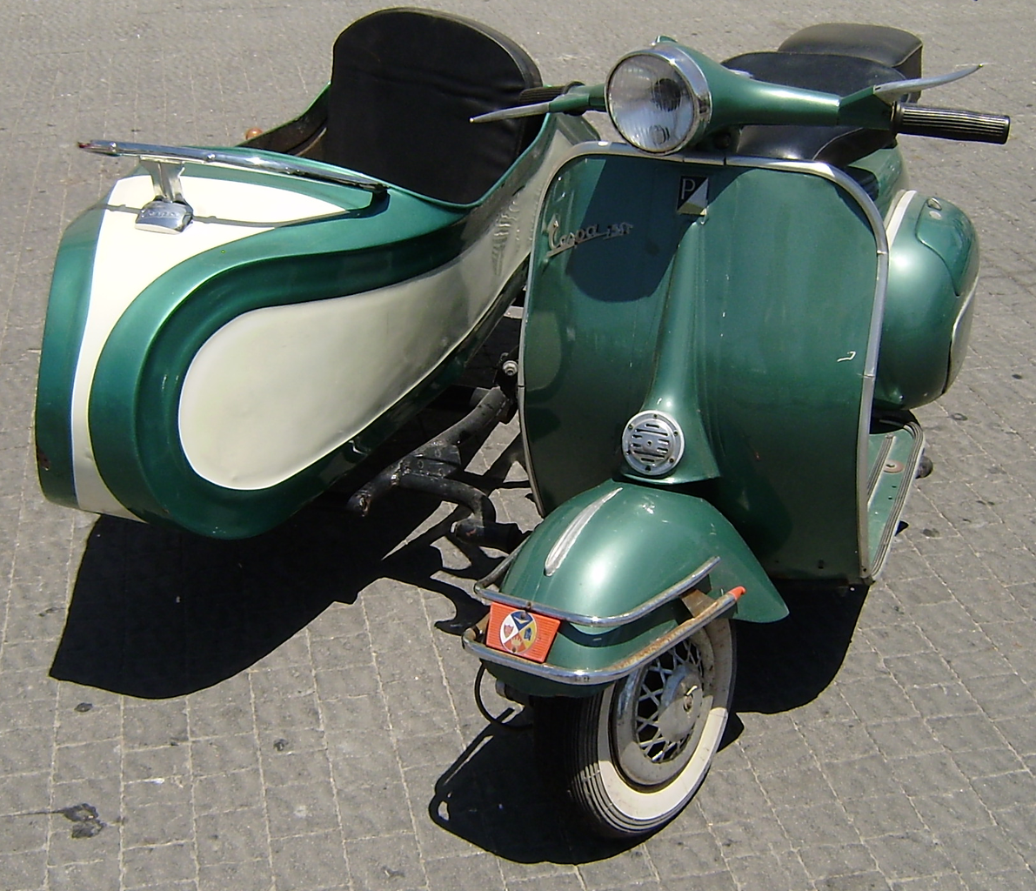
Sidecar

Slide 63
Advantages
Independent from primary application in terms of run time and the language in which they are implemented – loose coupling
Can access the same resource as primary application
Low latency due to proximity
Reduces the code duplication
Reduces the complexity in the main application

Slide 64
Issues & Concerns
Try to use language- or framework-agnostic technologies
Before putting functionality into a sidecar, consider whether it would work
better as a separate service or a more traditional daemon.
the functionality could be implemented as a library.
Containers are particularly well suited to the sidecar pattern.

Slide 65
What next??
Decomposition Pattern : Service-Mesh

Slide 66
Microservices Architecture
MICROSERVICES DESIGN PATTERNS
Decomposition Pattern : Service Mesh

Slide 67
Use Case (Problem Statement)
Communication Complexity
Failure Isolation
Service Discovery
Config changes
Order Management
Product Management
Account Management
Login Management
UI
Payment Management

Slide 68
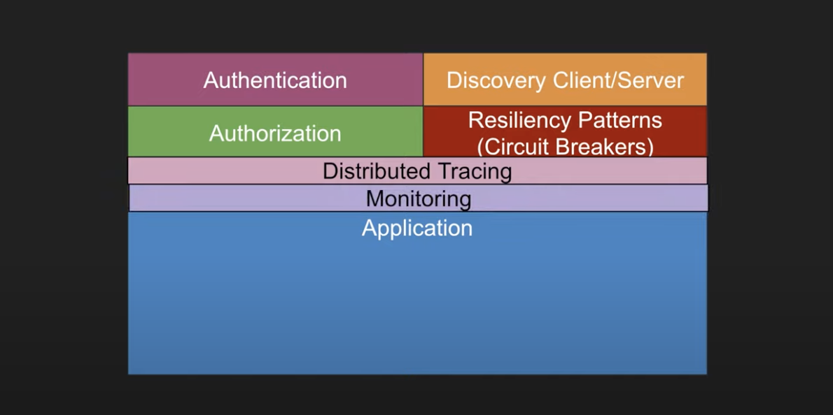

Slide 69
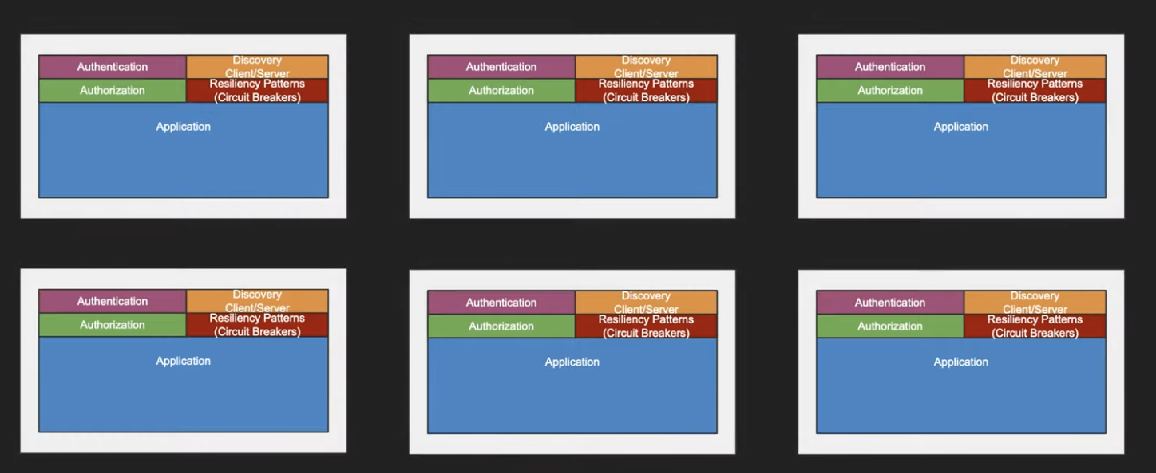

Slide 70
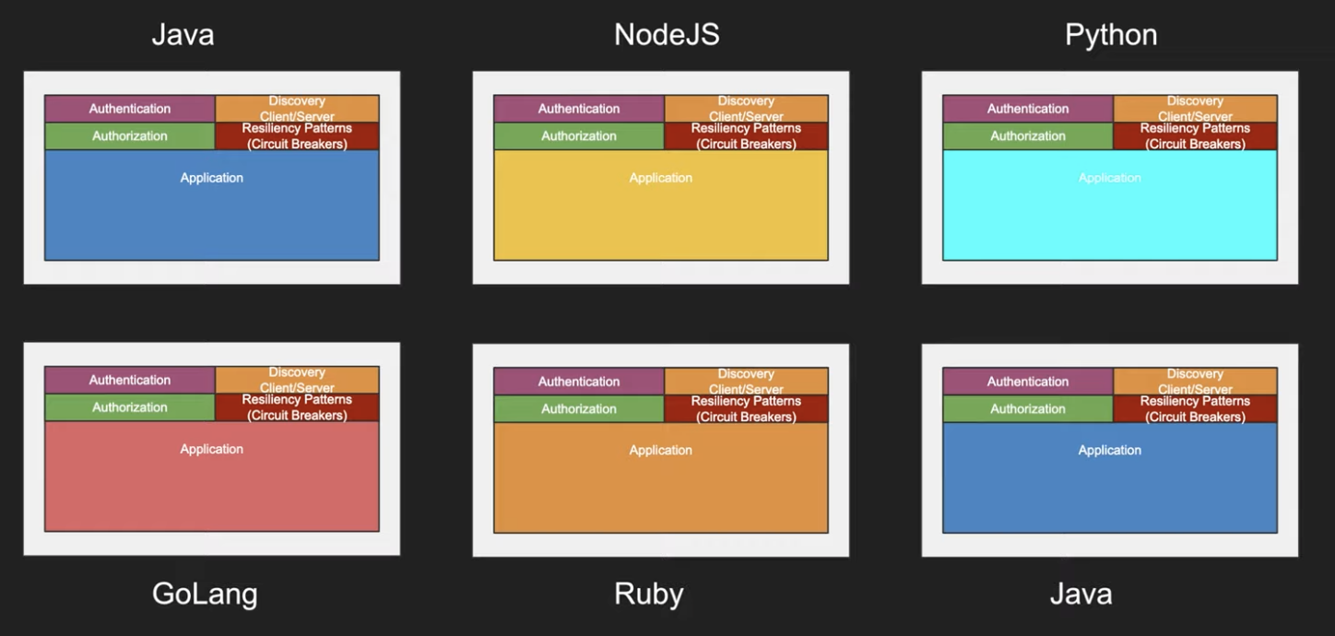

Slide 71
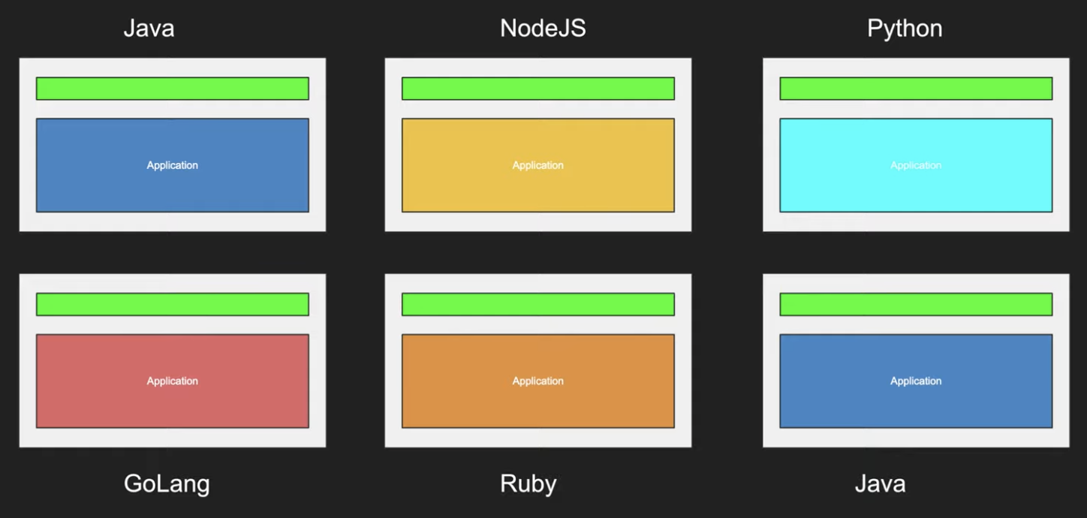

Slide 72
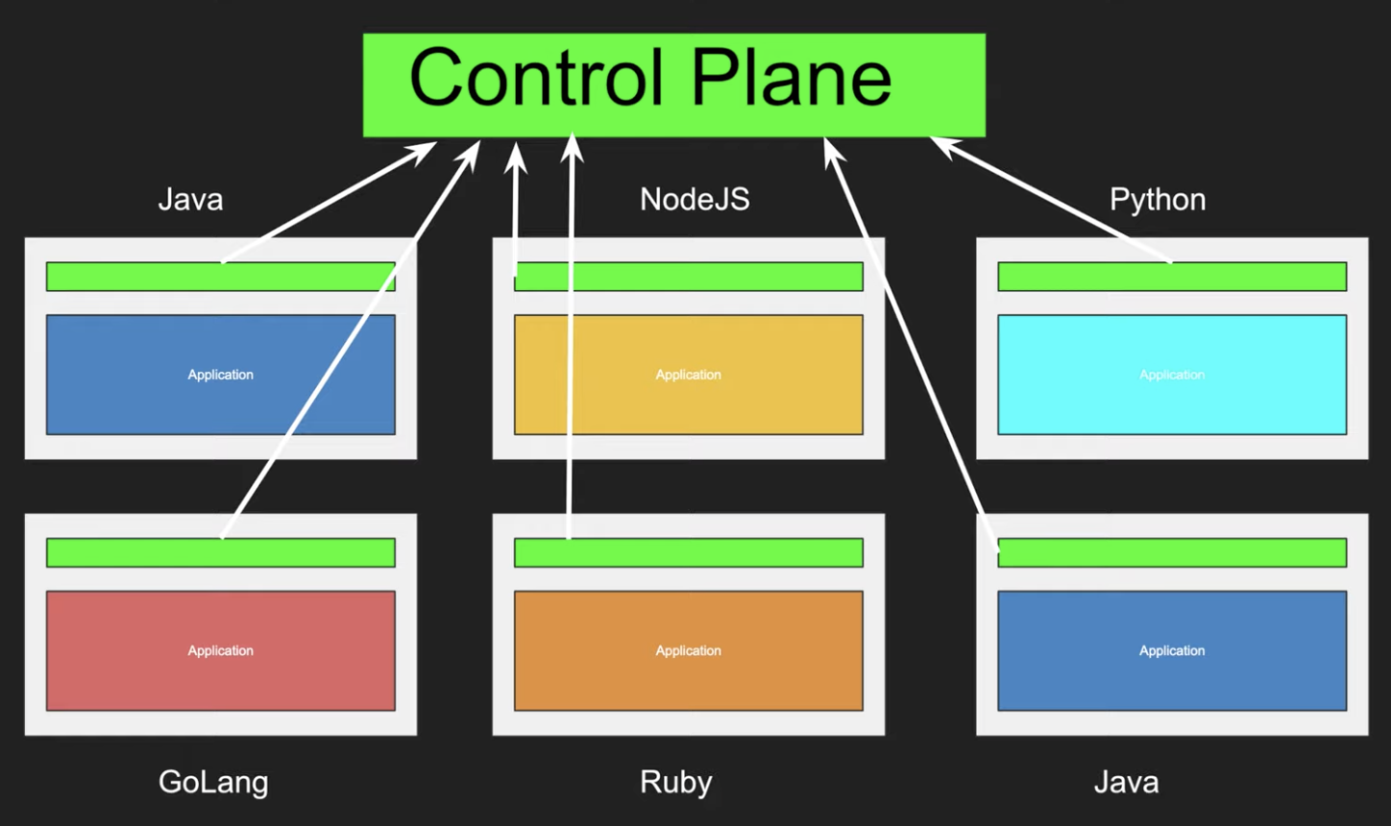

Slide 73
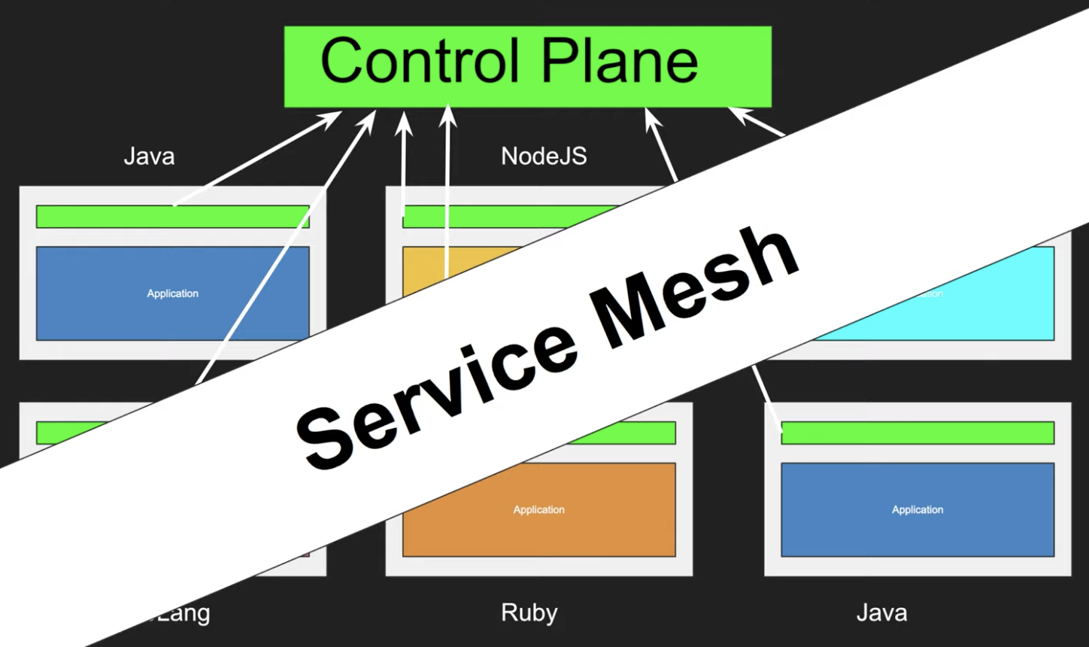

Slide 74
What is service mesh?
It’s dedicated infrastructure layer for service-to-service communication
focusing on managing all service-to-service communication within a distributed software system.
This makes communication optimization easier
It’s a way to control how different parts of an application share the data among themselves
Typically array of network proxies
Deployed alongside main service
Main service need not to be aware of this proxy
For cloud native application

Slide 75
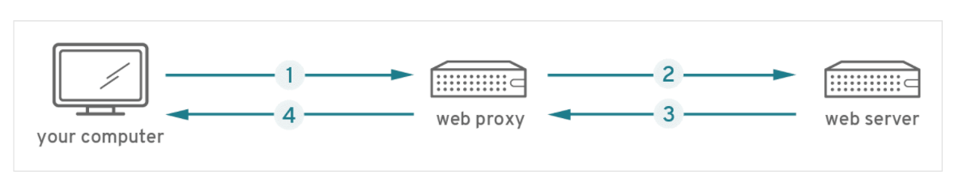
How does it work??
https://www.redhat.com/en/topics/microservices/what-is-a-service-mesh

Slide 76
Remember this one??
Order Management
SIDECAR
Product Management
Account Management
SIDECAR
SIDECAR
Login Management
Payment Management
SIDECAR
SIDECAR

Slide 77

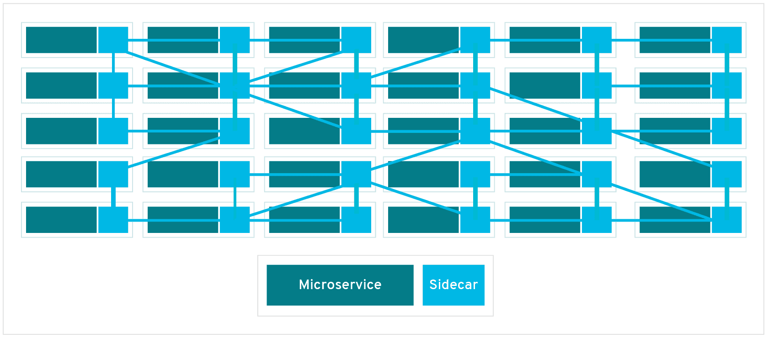
Now it’s like real Mesh

Slide 78
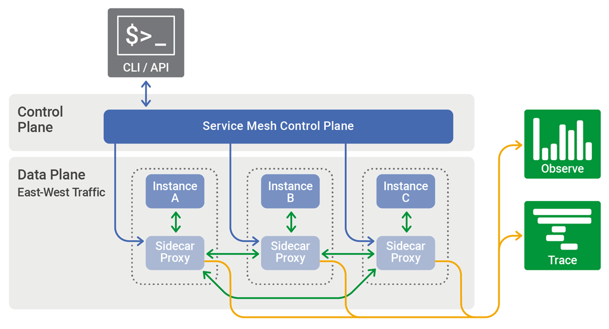
The control plane in a service mesh distributes configuration across the sidecar proxies in the data plane

Slide 79
Role of Service Mesh
Service Discovery
Fault Tolerance
Routing
Observability
Logging
Monitoring
Security
Access Control
Deployment

Slide 80
Pros & Cons
Pros
Centralized solution for logging, distributed tracing, logging security, access control
All of these are reusable for different microservices
Language agnostic for microservices
Cons
Complexity
Extra network hop
New and Immature

Slide 81
How to Implement Service Mesh
https://linkerd.io/
https://istio.io/
https://www.envoyproxy.io/
https://www.consul.io/

Slide 82
What next??
Decomposition Pattern : Summary

Slide 83
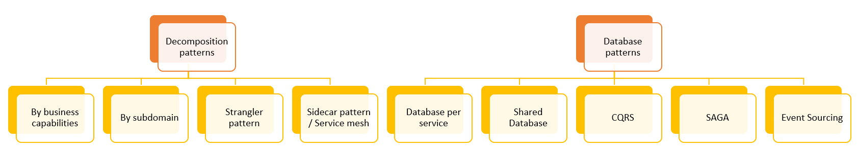
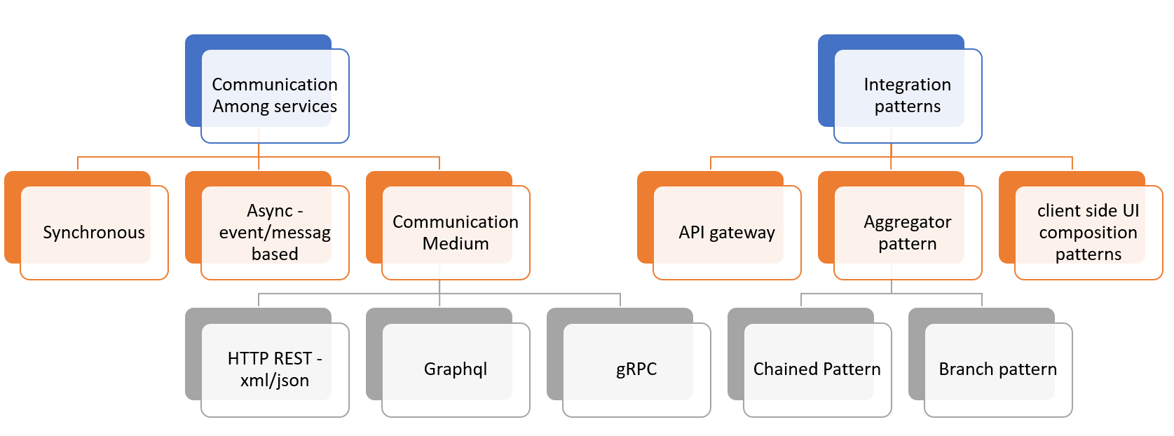
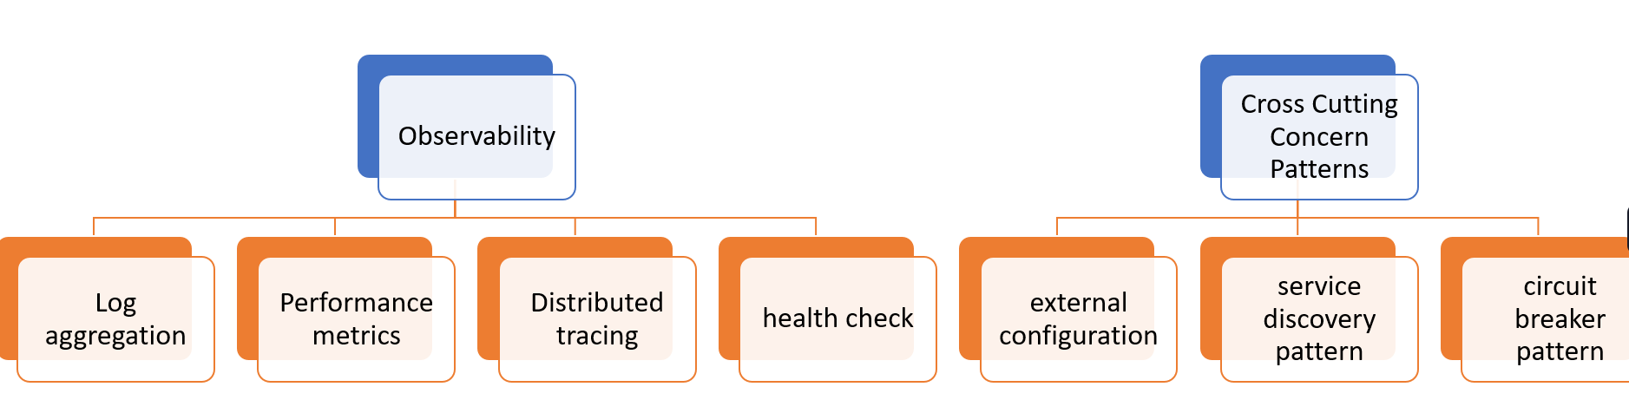
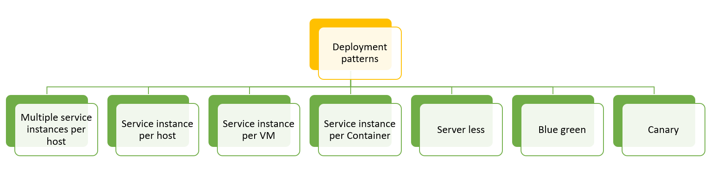

Slide 84
Microservices Architecture
MICROSERVICES DESIGN PATTERNS
Decomposition Pattern : Summary

Slide 87
What next??
Database Pattern : DB / Shared-DB per service

Slide 88
Microservices Architecture
MICROSERVICES DESIGN PATTERNS
Database Patterns :
DB / Shared-DB per service

Slide 89
Challenges with microservices architecture
Services must be loosely couples so that they can be
Developed independently
Deployed independently
Scaled independently
Unique requirement for each service
Different data
Different storage type

Slide 90
Database Per service

Slide 91
Database Per service
Benefits
Loosely coupled
Free to choose database type e.g. RDBS, mongo Cassandra etc.
if you are using a relational database then the options are:
Private-tables-per-service –
each service owns a set of tables that must only be accessed by that service
Schema-per-service –
each service has a database schema that’s private to that service
Database-server-per-service –
each service has it’s own database server.

Slide 92
Database Per service
Challenges
Queries that needs join over multiple database
Transactions across multiple databases
Solutions
Queries that needs join over multiple database
CQRS
Event Sourcing
API Compositions
Transactions across multiple databases
Saga Pattern

Slide 93
Shared DB per service
Brownfield Projects

Slide 94
Shared DB per service
Brownfield Projects
ORDER table
Id | Cust_id | Status | sum | ..
12345 | 9876 | Complete | 1000
Customer table
Id | name | address | Address_type
9876 | xyz | Noida | home
1111 | abc | Delhi | office

Slide 95
Shared DB per service
Benefits
Familiar
Simpler to operate
Drawbacks
Runtime coupling
Development time coupling
Might not satisfy the storage and access requirement of all services

Slide 96
What next??
Database Pattern : CQRS

Slide 97
Microservices Architecture
MICROSERVICES DESIGN PATTERNS
Database Patterns :
CQRS(Command Query Responsibility Segregation)

Slide 98
Problem Statement
Create
Update
Delete
Product Service
View Only
Order Service

Slide 99
The Way out
Product Service
History Service
Order Service
View Only
Create
Update
Delete

Slide 100
CQRS
Create
Update
Delete
Command
Query
Responsibility
Segregation
View Only

Slide 101
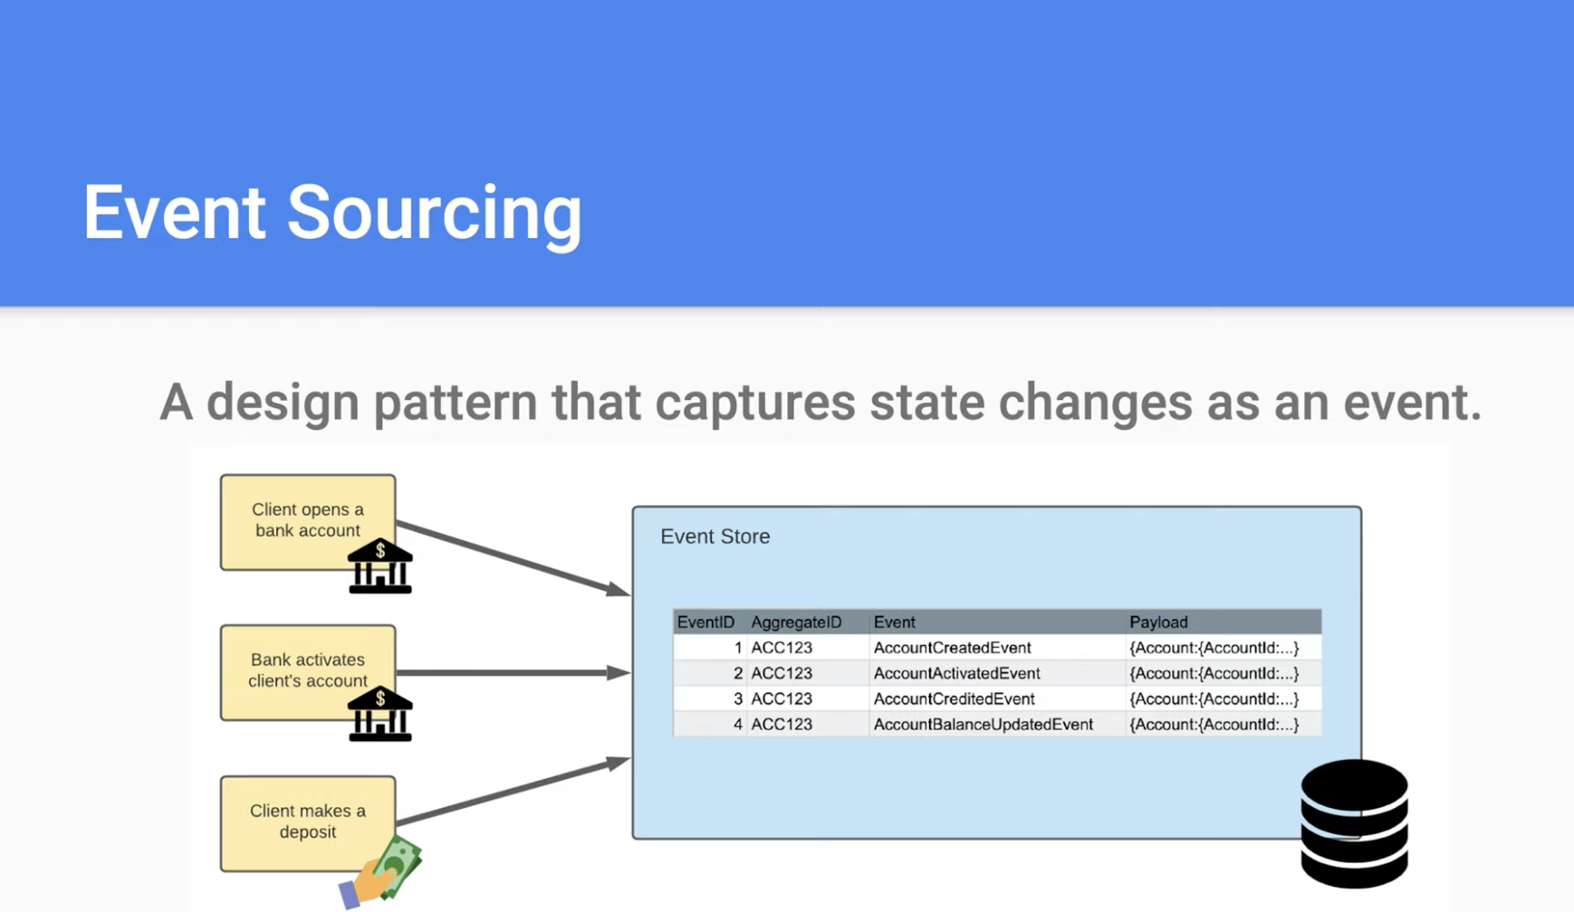

Slide 102
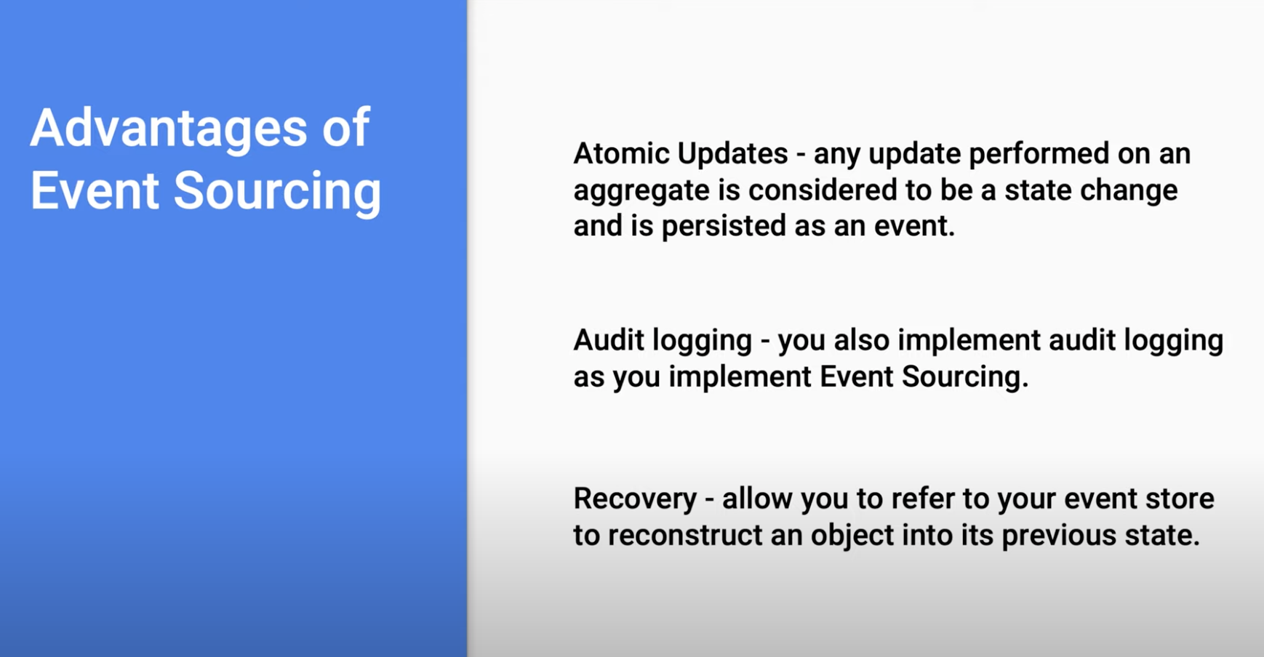

Slide 103
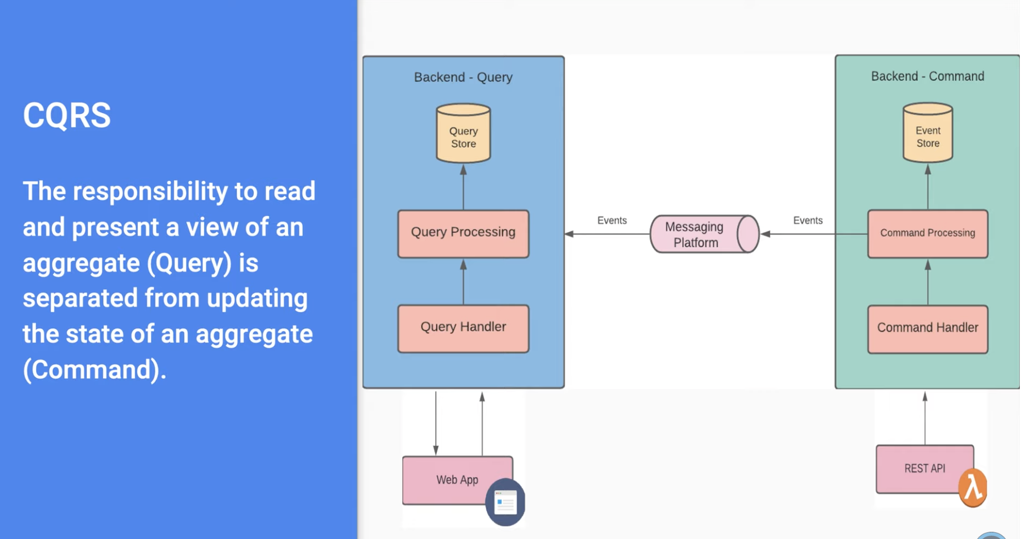

Slide 104
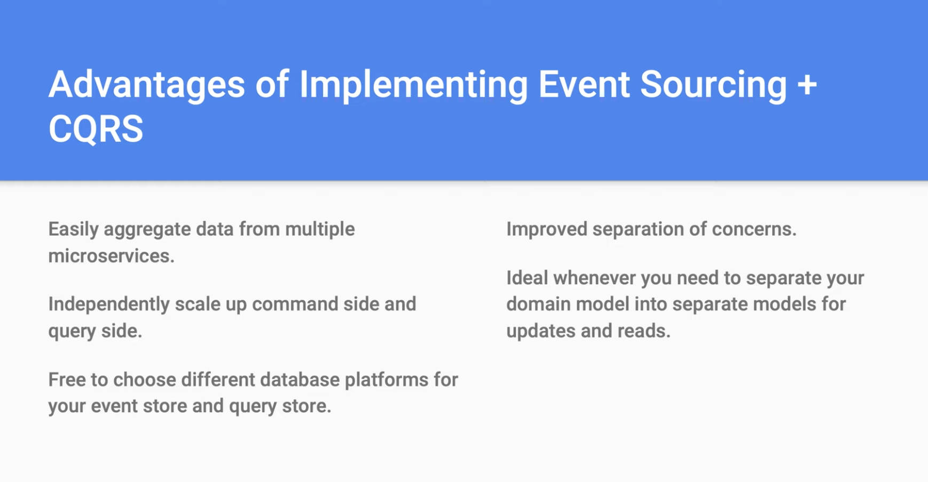

Slide 105
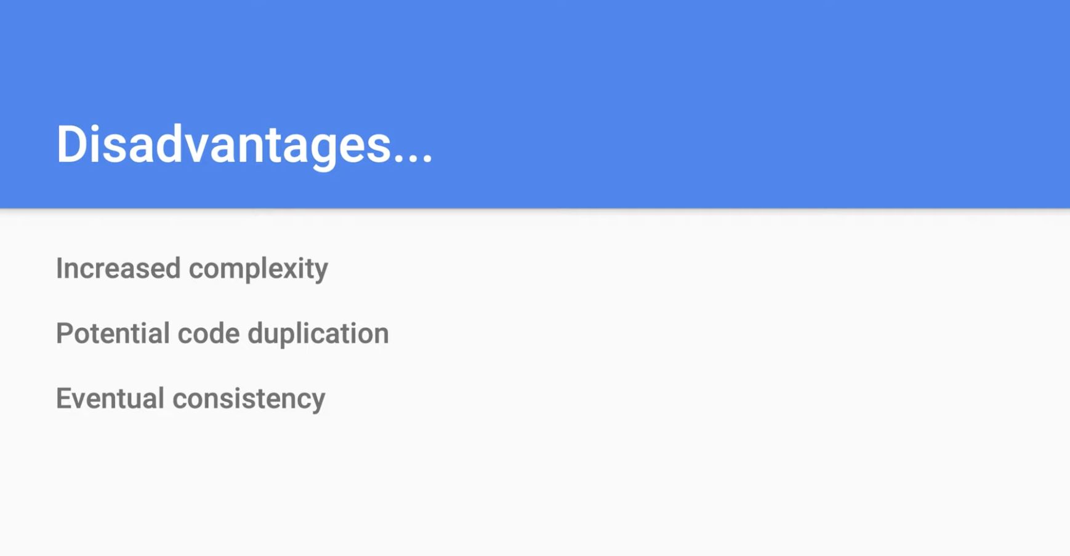

Slide 106
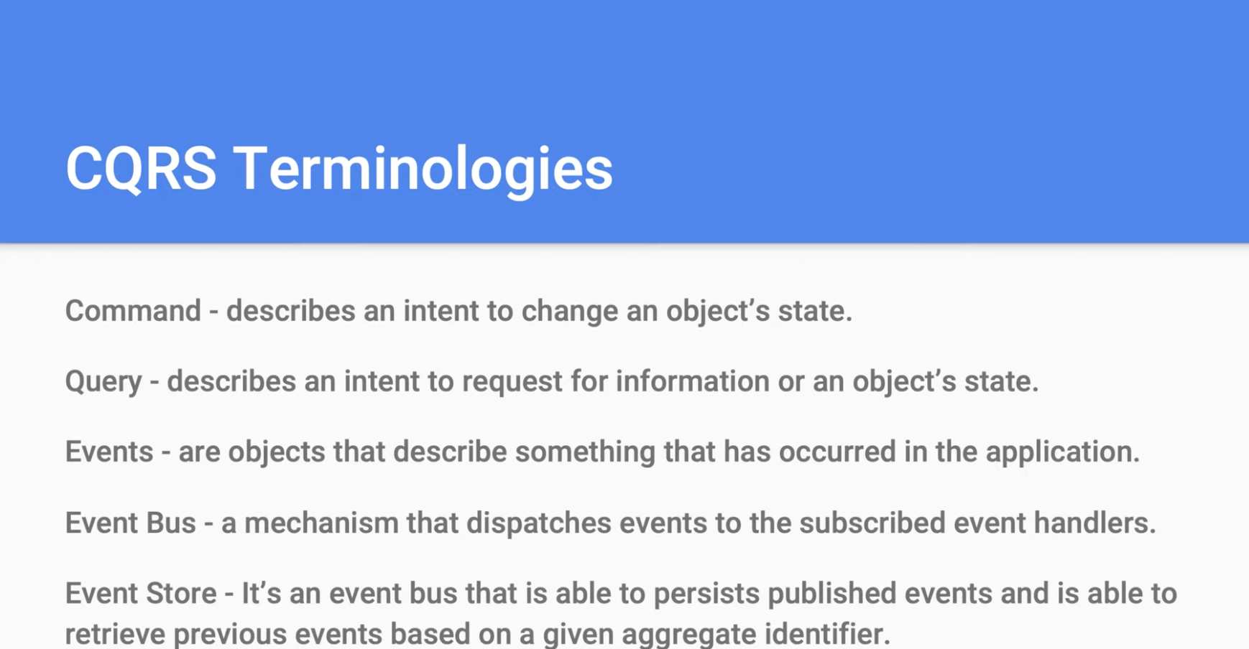

Slide 107
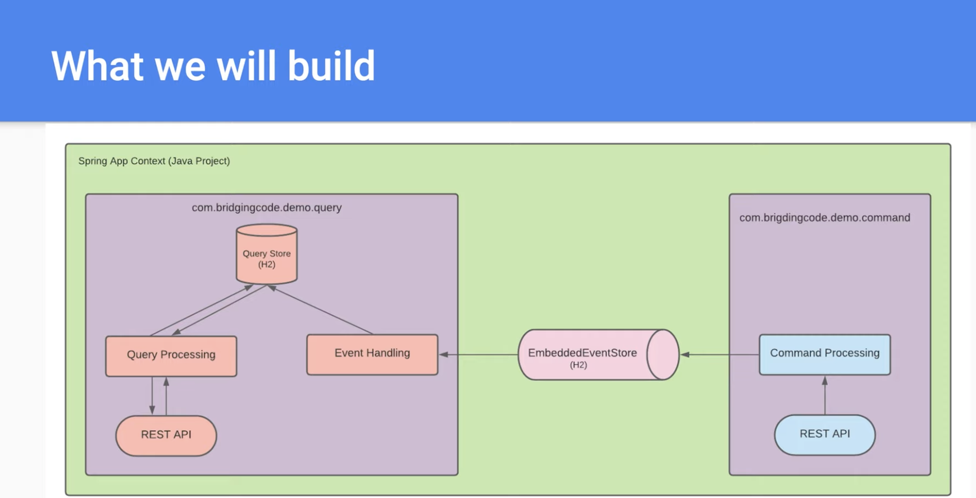

Slide 108
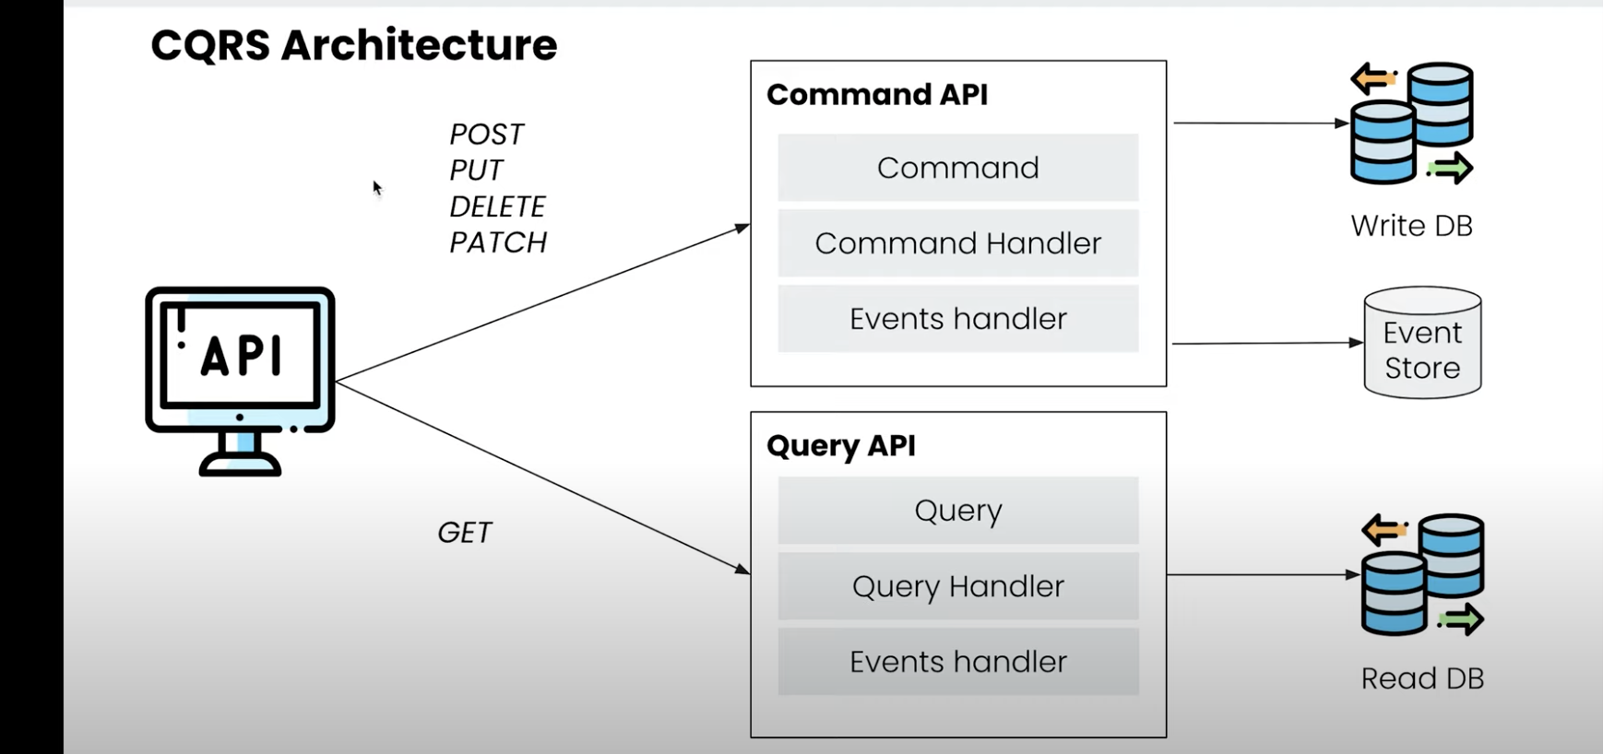

Slide 109
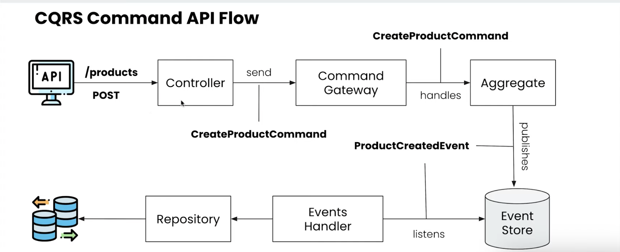

Slide 110
MICROSERVICES ARCHITECTURE
Database triggers and procedures
Product Service
History Service
Product Event
Event handlers
Order Service
Create
Update
Delete
Order Event
View Only

Slide 111
CQRS : Challenges
How the data will come to History Service Database?
Events
Database replication methods
Replication delay
Extra complexity
Code Duplication

Slide 112
CQRS : Benefits
Responsibility segregation which is the core principle of microservices/distributed systems
Simpler command and query models
Flexibility to choose database for view
Easy to scale

Slide 113
What next??
Eventual Consistency

Slide 114
Microservices Architecture
MICROSERVICES DESIGN PATTERNS
Data Consistency
Eventual
Strong

Slide 115

Data Consistency in Distributes Systems
Eventual Consistency
Strong/Strict Consistency
Node1
Node2
Node3
Node4
Node-n

Slide 116
Eventual Consistency
Node1
Node2
Node3
Node4
Node-n

Slide 117
Strong/Strict Consistency
Node1
Node2
Node3
Node4
Node-n

Slide 118
Eventual vs Strong Consistency
Eventual consistency guarantees low latency with some stale data
Strong consistency guarantees updated/latest data with some higher latency

Slide 119
What next??
Database Pattern : Event Driven

Slide 120
Microservices Architecture
MICROSERVICES DESIGN PATTERNS
Database Pattern :
Event Driven

Slide 121
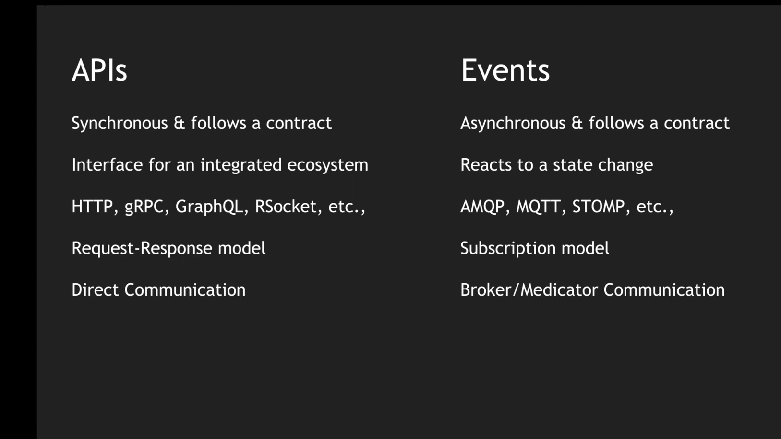

Slide 122
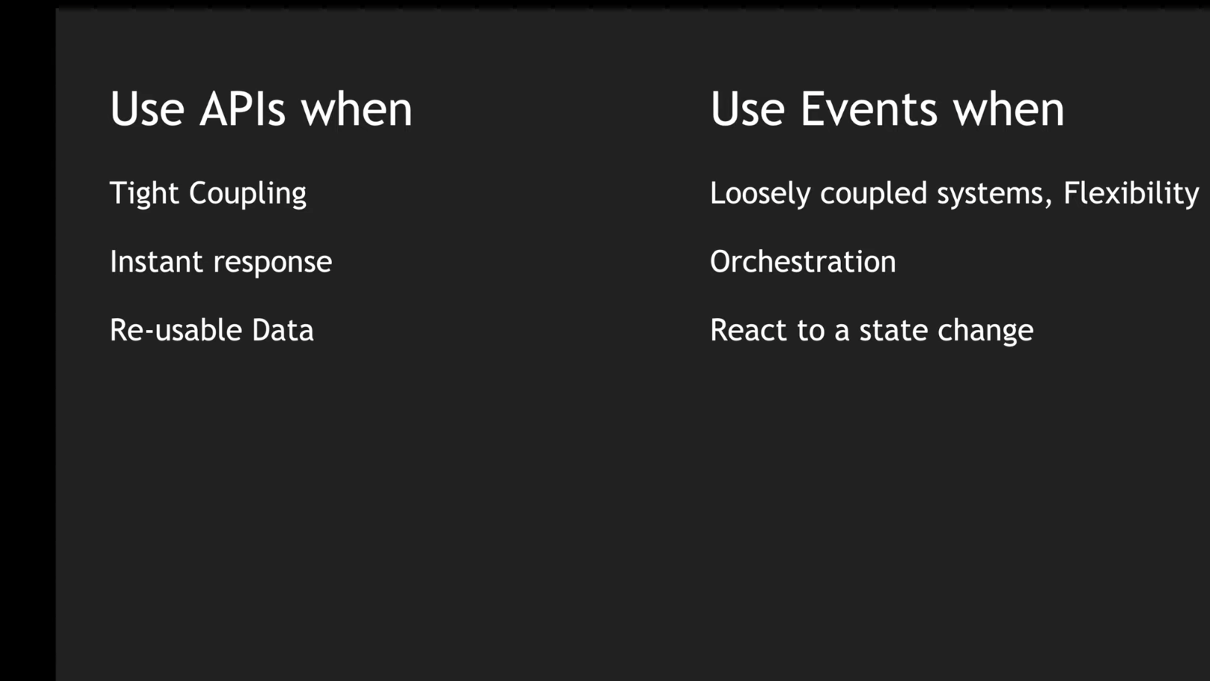

Slide 123
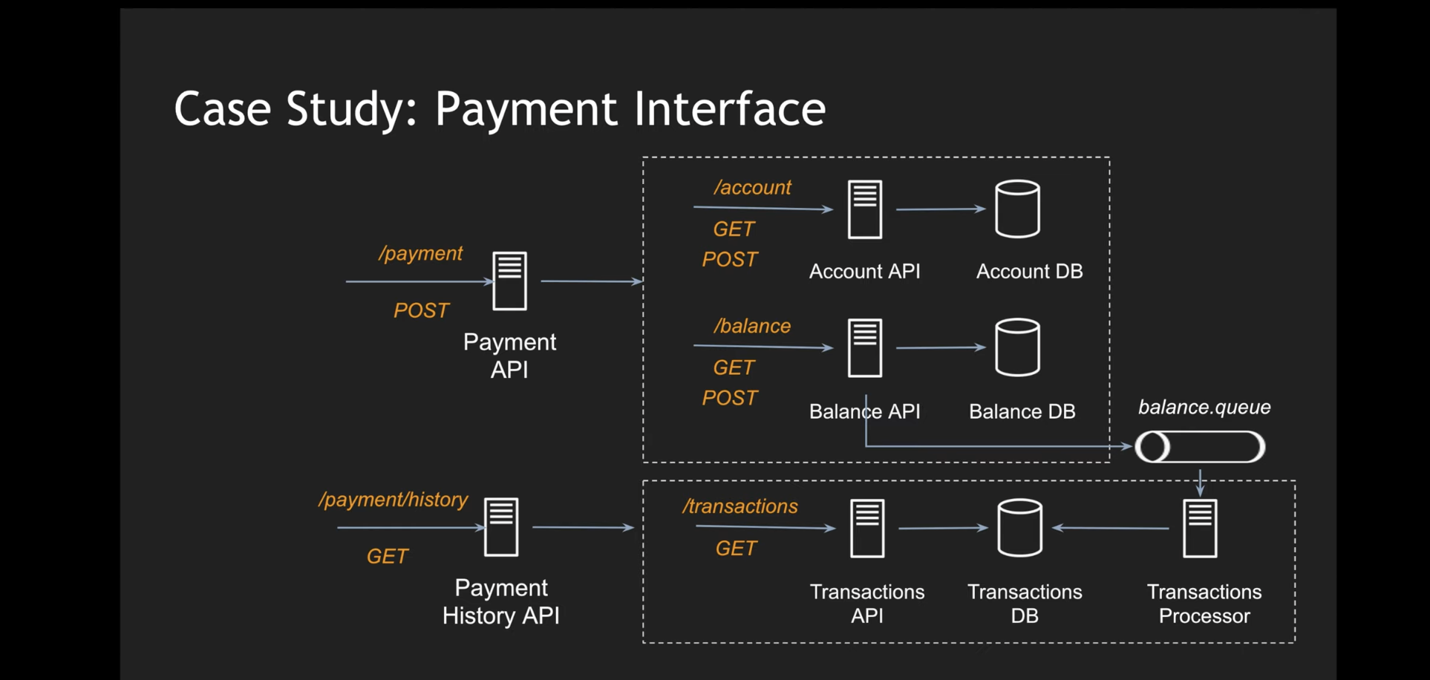

Slide 124
Event-Driven System
History Service
Use of Message Brokers
Decoupled architecture
Asynchronous communication
Product Service
Mailing Service
Message Broker
Order Service
Analytics Service
Service -n

Slide 125
Event Notification Event Carried State Transfer https://martinfowler.com/articles/201701-event-driven.html

Slide 126
What next??
Database Pattern : Event Sourcing

Slide 127
Microservices Architecture
MICROSERVICES DESIGN PATTERNS
Database Pattern :
Event Sourcing

Slide 128
Event-Sourcing System
Order Service
State is stored as a series of events
Any record is about the state change from previous one
We can always replay events to get the state at any point of time
E.g. Git Commit
Efficient
Asynchronous communication
Storage vs performance
Regular snapshots
orderofevents
Archive
Ask for feedback
Mail to user
Inventory update
Completed
Pending
Initiated

Slide 129
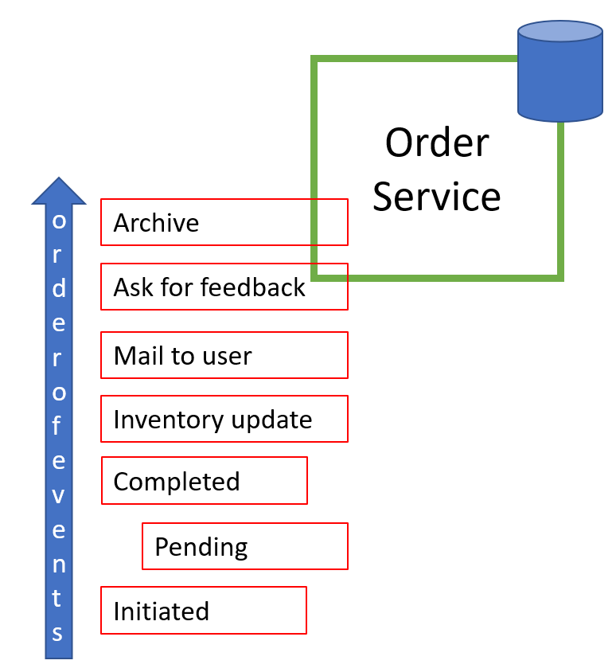
Event-Sourcing System
History Service
Mailing Service
Message Broker
Analytics Service
Service -n

Slide 130
What next??
Database Pattern : 2 Phase Commit

Slide 131
Microservices Architecture
MICROSERVICES DESIGN PATTERNS
Database Pattern :
2 Phase Commit

Slide 132
Transactions
ACID
Atomicity
Consistency
Isolation
Durability

Slide 133
Transactions
Monolithic Applications
Microservices

Slide 134
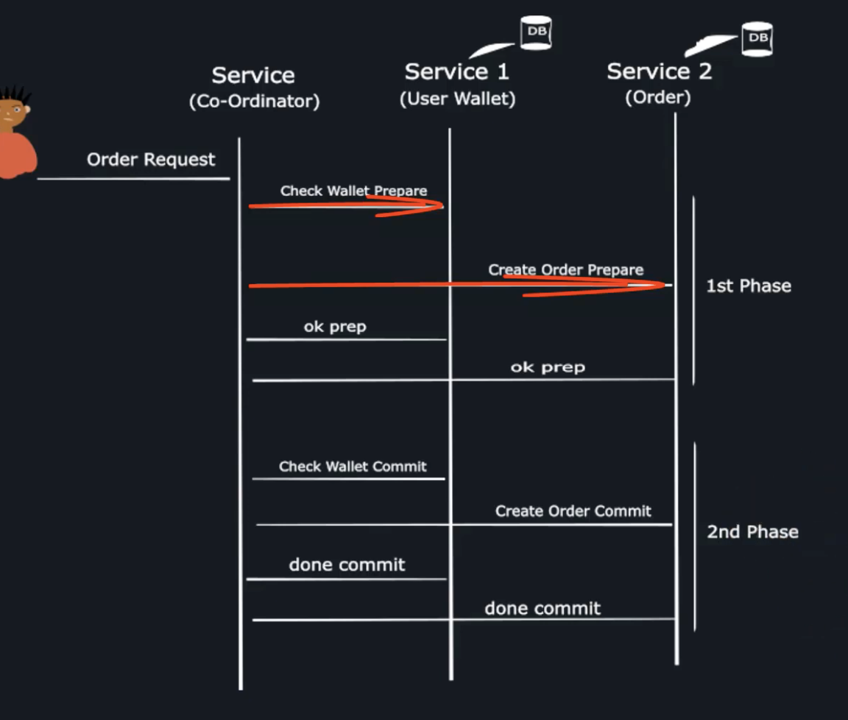

Slide 135
2 Phase Commit Protocol
XA(Extended Architecture)
It’s a pattern for distributed transactions
ACID like properties for global/distributed transaction processing
Transaction manager manages the transactions
Preparation for commit or abort
Perform commit or abort

Slide 136
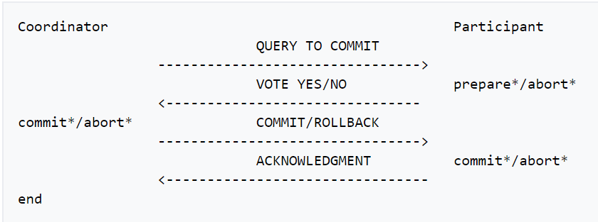
Basic Algorithm
Phase 1 – Preparation/Voting
TM sends query to commit to all participants
Participants reply with appropriate message(Yes/No)
Also makes an entry in undo and redo logs
Phase 2 - Action
Commit
TM Sends commit message to all participants
Each participants completes the operation and releases the lock
Sends acknowledgement to TM
TM marks the transaction complete with success
Abort
TM Sends abort message to all participants
Each participants aborts the operation and releases the lock
Sends acknowledgement to TM
TM marks the transaction complete with failure

Slide 137
Preparation Phase
Order Service
Inventory Service
Transaction Manager
Prepare
Delivery Service
Mail Service

Slide 138
Voting Phase – All Yes
Yes
Order Service
Yes
Inventory Service
Transaction Manager
Yes
Delivery Service
Yes
Mail Service

Slide 139
Action - commit
Order Service
Inventory Service
Transaction Manager
commit
Delivery Service
Mail Service

Slide 140
Voting Phase – No by at least on service
Yes
Order Service
Yes
Inventory Service
Transaction Manager
Yes
Delivery Service
No
Mail Service

Slide 141
Action - Rollback
Order Service
Inventory Service
Transaction Manager
Rollback
Delivery Service
Mail Service

Slide 142
Challenges with 2 Phase Commit
Complete reliance on transaction manager
One point failure
Scaling issues
Reduced throughput
No response from participant services
Then resources is locked until timeout
Commit failure after successful vote
Locks resources due to pending transactions

Slide 143
What next??
Database Pattern : Saga

Slide 144
Microservices Architecture
MICROSERVICES DESIGN PATTERNS
Database Pattern : Saga

Slide 145
Problem Statement
Transaction
Single unit of logic or work
Spread across multiple services in distributed systems
History Service
Transactions must be
Atomic
Consistent
Isolated
Durable
Mailing Service
Analytics Service
Within a single service maintaining ACID properties for transactions are easy, but
Cross-service transaction requires a cross-service transaction management strategy.

Slide 146
What is Saga?
It’s a way to manage data consistency across microservices in distributed transaction scenarios.
It’s a sequence of transactions that updates each service and publishes a message or event to trigger the next transaction step.
If a step fails, the saga executes compensating transactions that counteract the preceding transactions.

Slide 147
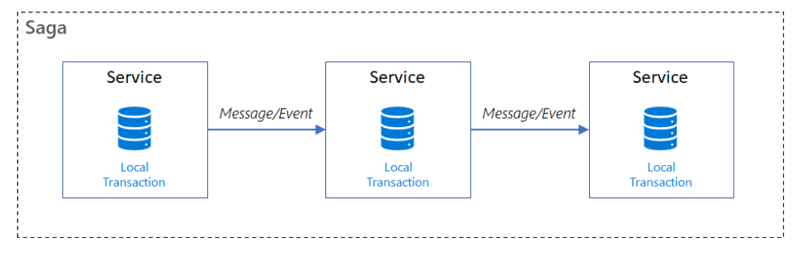
Saga
Sequence of local transactions
Each local transaction updates the database and published the event for next service
If any of the local transaction fails then saga publishes COMPENSATING transactions to all the services which have performed commit

Slide 148
Saga patterns have -
Compensable transactions are transactions that can potentially be reversed by processing another transaction with the opposite effect.
A pivot transaction is the go/no-go point in a saga. If the pivot transaction commits, the saga runs until completion. A pivot transaction can be a transaction that is neither compensable nor retryable
Retryable transactions are transactions that follow the pivot transaction and are guaranteed to succeed.

Slide 149
Saga Implementation
Choreography
Orchestration

Slide 150
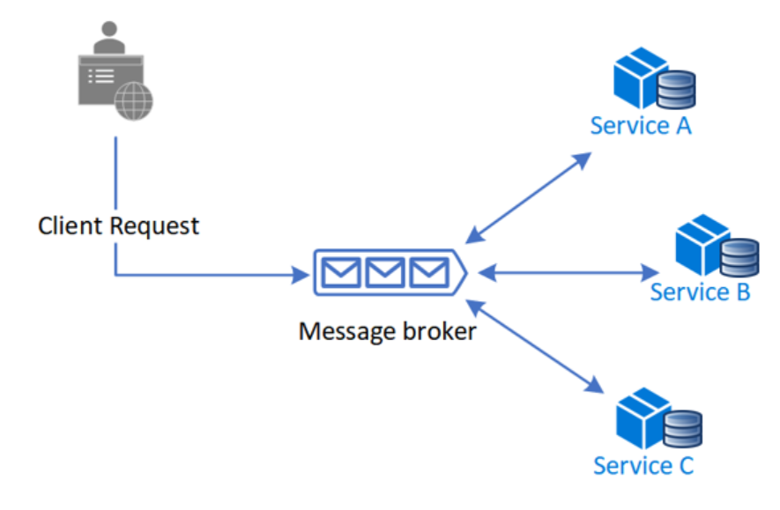
Choreography
Benefits
good for simple workflows which have few services
No additional service
No single point of failure
Drawbacks
Can be confusing when adding new steps
Cyclic dependency risk
Integration testing is difficult

Slide 151
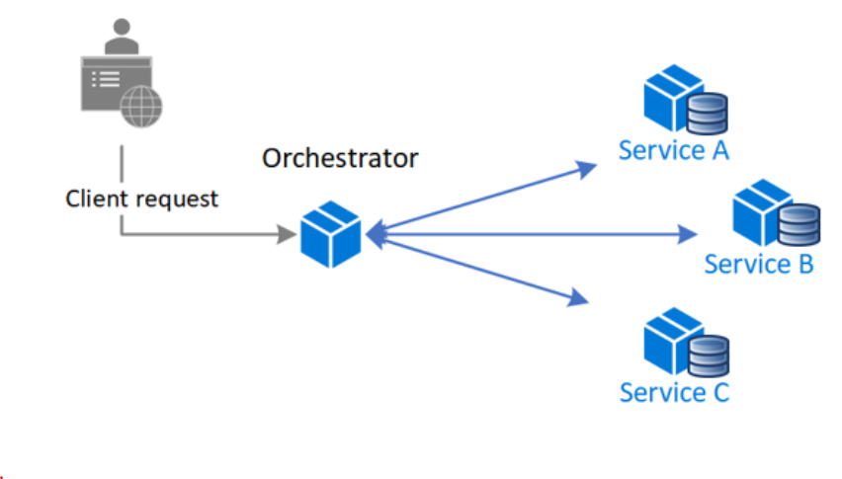
Orchestration
Benefits
good for complex workflows which have many services and new service can be added at any time
Suitable when there is control over all participants and control over the flow of activities
No Cyclic dependency risk
Clear separation of concern, separate from business logic
Drawbacks
Additional design complexity
Additional point of failure

Slide 152
ORDER SERVICE
SAGA
EXECUTION
COORDINATOR
(SEC)
Start Saga
S
A
G
A
L
O
G
History Service
Request 1
Request 1
Request 2
Mailing Service
Request 2
Request 3
Analytics Service
Request 3
End Saga

Slide 153
ORDER SERVICE
SAGA
EXECUTION
COORDINATOR
(SEC)
Start Saga
S
A
G
A
L
O
G
History Service
Request 1
Request 1
Request 2 failed
Mailing Service
Request 2 - falied
Compensation Req 1
History Service
Compensation Req 1
Analytics Service
End Saga

Slide 154
When to use saga?
When you need to
Ensure data consistency in a distributed system without tight coupling.
Rollback if one of the operations in the sequence fails.
Less suitable for
Tightly coupled transaction
Compensating transactions that occur in earlier participants.
Cyclic dependencies.
https://docs.microsoft.com/en-us/azure/architecture/reference-architectures/saga/saga

Slide 155
What next??
Database Pattern : Summary

Slide 156
Microservices Architecture
MICROSERVICES DESIGN PATTERNS
Database Patterns : Summary

Slide 157
Database Patterns for microservices
Database per service
Shared Database per service
CQRS
Data consistency – Eventual vs Strong
Event Driven
Event sourcing
2 Phase Commit
Saga

Slide 159
What next??
Communication : Synchronous vs Asynchronous

Slide 160
Microservices Architecture
MICROSERVICES DESIGN PATTERNS
How Microservices Communicate with Each Other??

Slide 161
Online Shopping Portal : Monolithic
Product Module
listProduct(productId){
//validateUser() //check For Products
//notifyMerchant(productId)
//return Products }
Payment Module
makePayment(){
//validateUser()
//process the payment
//return response }
Login Module
validateUser(){ //validate user credentials
//return validation status }
Order Module
placeOrder(cartId){
//validateUser() //checkProductAvailability()
//makePayment()
//placeOrder
//notifyUser()
//return response }
Mailing Module
notifyUser() {
//mail/sms to the user about order }

Slide 162
Online Shopping Portal : Microservices
Product Service
listProduct(productId){
//validateUser() //check For Products
//notifyMerchant(productId)
//return Products }
Payment Service
makePayment(){
//validateUser()
//process the payment
//return response }
Login Service
validateUser(){ //validate user credentials
//return validation status }
Order Service
placeOrder(cartId){
//validateUser() //checkProductAvailability()
//makePayment()
//placeOrder
//notifyUser()
//return response }
Mailing Service
notifyUser() {
//mail/sms to the user about order }

Slide 163
Challenges
How to connect 2 services?
How to process the request & response?
Network latency
HTTP
Hyper Text Transfer Protocol
RPC
Remote Procedure Call
Messaging
XML
Extensible Mark-up Language
JSON
Java Script Object Notation
https://github.com/greenlearner01/JSON
Synchronous
Asynchronous

Slide 164
What next??
Synchronous vs Asynchronous

Slide 165
Microservices Architecture
MICROSERVICES DESIGN PATTERNS
Synchronous vs Asynchronous Communication

Slide 166
Synchronous Communication
Product Service
Payment Service
Order Service
Mailing Service
Analytics Service

Slide 167
Asynchronous Communication
Message based
Call-back
Product Service
Payment Service
Order Service
Mailing Service
Message Broker
Analytics Service

Slide 168
Synchronous
Asynchronous
Easy to implement
Easy to test
Easy to debug
Blocking
Slow due to waiting
High coupling
Reliable due to response
Difficult due to message broker
Difficult to test
Difficult to debug
Non-blocking
Fast
Loose coupling
Not Reliable due to no-response

Slide 169
Which one should we use??

Slide 170
What next??
All about HTTP

Slide 171
Microservices Architecture
MICROSERVICES DESIGN PATTERNS
How to setup Synchronous Communication among microservices? HTTP

Slide 172
server
client
Request
Response

Slide 173
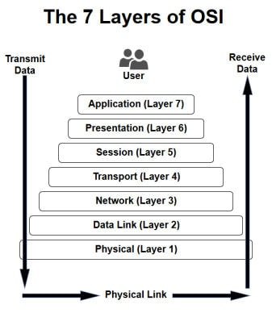
HTTP : Hyper Text Transfer Protocol
Communication protocol that transports messages from one place to other over a network
Stateless
State is maintained using cookies or session
Application layer protocol

Slide 174
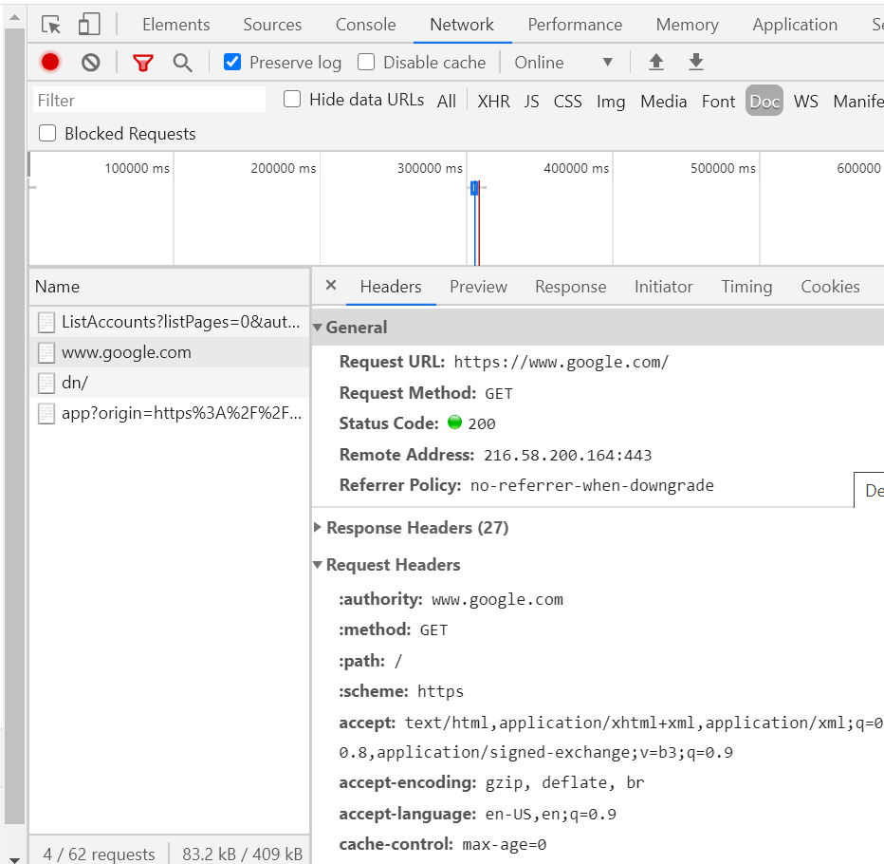
Http Request Format
URL
Method
GET
POST
PUT
Delete etc..
Headers
Body[optional]

Slide 175
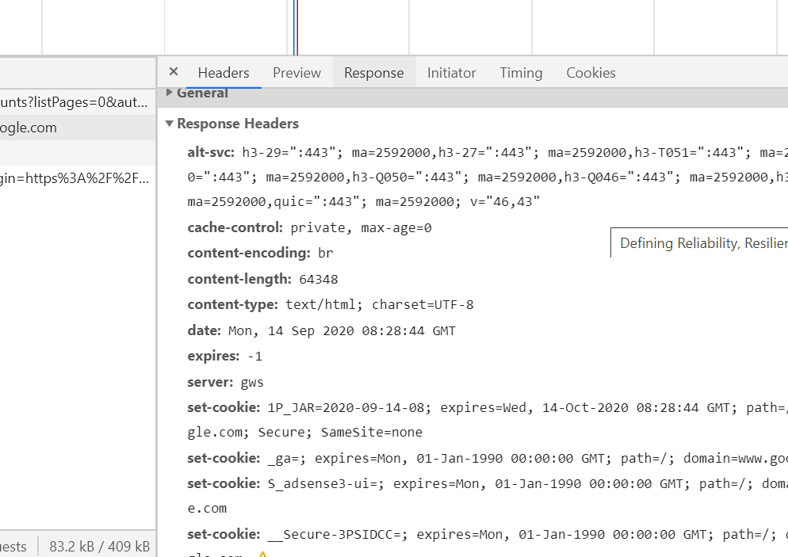
Http Response Format
http status code
Informational responses (100–199),
Successful responses (200–299),
Redirects (300–399),
Client errors (400–499),
and Server errors (500–599).
Headers
Body[optional]

Slide 176
Online Shopping Portal : Microservices
Product Service
listProduct(productId){
//validateUser() //check For Products
//notifyMerchant(productId)
//return Products }
Payment Service
makePayment(){
//validateUser()
//process the payment
//return response }
Login Service
validateUser(){ //validate user credentials
//return validation status }
Order Service
placeOrder(cartId){
//validateUser() //checkProductAvailability()
//makePayment()
//placeOrder
//notifyUser()
//return response }
Mailing Service
notifyUser() {
//mail/sms to the user about order }

Slide 177
What next??
Message based communication

Slide 178
Microservices Architecture
MICROSERVICES DESIGN PATTERNS
How to setup Asynchronous communication :
Message Based

Slide 179
Different approaches for message based communication
Notifications
Request/asynchronous response
Publish/subscribe
Publish/asynchronous response

Slide 180
How to implement the messaging based communication??

Slide 181


Microservice B
Microservice A
Queue 1
Microservice C
Queue 2
Microservice D

Slide 182


Microservice B
Microservice A
Queue 1
Microservice C
Queue 2
Microservice D

Slide 183


Microservice B
Microservice A
Topic 1
Microservice C
Topic 2
Microservice D

Slide 184
What next??
GraphQL

Slide 185

Microservices Architecture
MICROSERVICES DESIGN PATTERNS
What is GraphQL?

Slide 186
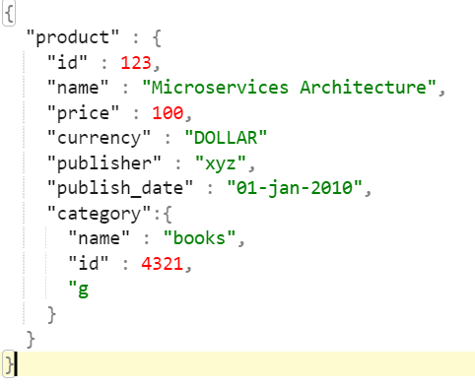
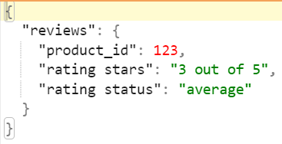
Current Scenario
Product Service
GET /product/{id}
Payment Service
Client Service
GET /product/{id}/reviews
Order Service
UI

Slide 187
Problem with current scenario??
Problem with current scenario??
Overfetching
Underfetching

Slide 188
GraphQL
GraphQL is the better REST
Query language for your API
Strong type system to define the capabilities of the API
An schema serves as contract between client and server

Slide 189
What next??
Microserivces Communication patterns: Summary

Slide 190
Microservices Architecture
MICROSERVICES DESIGN PATTERNS
Microserivces Communication Patterns
Summary

Slide 191
Summary
How microservices talk to each other?
Synchronous vs Asynchronous communication
How to setup synchronous communication
How to setup Asynchronous communication – Message Bases
REST API
GraphQL

Slide 193
What next??
Microservices Integration Patterns:
API gateway

Slide 194
Microservices Architecture
MICROSERVICES DESIGN PATTERNS
Microservices Integration Patterns:
API Gateway

Slide 195
How do the clients of microservices based application access the individual microservice??

Slide 196


Direct Communication
Online Shopping Portal
Product Service
Aggregating data from multiple services
Too much chatty behaviour between clients and services
Non-web friendly protocol -> AMQP
How to handle the change in location(host + port) of services
Cross cutting concerns like
Security (Authentication & Authorization)
Logging, tracing
Load balancing
Caching
IP whitelisting
Request/response transformations
Failure handling – circuit breaker
Addressing the needs of different clients like desktop, mobile or any other service
High coupling for each client
Payment Service
Order Service
3rd party service
Inventory Service

Slide 197
API GATEWAY
Online Shopping Portal
Product Service
S
I
N
G
L
E
E
N
T
R
Y
P
O
I
N
T
Payment Service
Order Service
3rd party service
Inventory Service

Slide 198
API GATEWAY(Backend for frontend-BFF)
Online Shopping Portal
Product Service
Single entry point
Payment Service
Single entry point
Order Service
Single entry point
3rd party service
Inventory Service

Slide 199
API Gateway
Aggregating data from multiple services
Reduces the request roundtrips
Non-web friendly protocol
Client is able to use single standard protocol to communicate to API gateway and independent of what protocol is used in specific service
How to handle the change in location(host + port) of services
Not the headache of client
Cross cutting concerns like (All of these are now responsibility of API gateway, centralized/clean/standard code)
Security(Authentication & Authorization)
Logging, tracing
Load balancing
Caching
IP whitelisting
Request/response transformations
Failure handling – circuit breaker
Addressing the needs of different clients like desktop, mobile or any other service
High coupling for each client
Now each client has it’s own optimal API gateway

Slide 200
Few Drawbacks
Extra application
Increased complexity of overall application
Increased latency

Slide 201
Implementations
Write your own API gateway
Netflix Zuul - https://www.youtube.com/playlist?list=PLq3uEqRnr_2GleAdJYmlBkB_RfbjMGdoH
Spring cloud gateway – Coming Soon
3rd Party providers
Kong - https://konghq.com/kong
Apigee – https://cloud.google.com/apigee
Amazon API Gateway - https://aws.amazon.com/api-gateway

Slide 202
What next??
Microservices Integration Patterns:
Aggregator

Slide 203
Microservices Architecture
MICROSERVICES DESIGN PATTERNS
Microservices Integration Patterns:
Aggregator

Slide 204
What is aggregator pattern
Collaborating data returned by each service
Composite microservice
Calling all the services needed to make the response
Transform the response as per clients need
Return back to client
API gateway can also do the aggregator job
Service E
Service A
Service B
Service C
Service D
Service F
Client

Slide 205
Aggregator Pattern
Branch Pattern
Chained Pattern

Slide 206
Chained Pattern
Service B
Service A
Service C
Client

Slide 207
Branch Pattern
Service E
Service B
Service A
Service C
Client
Service D

Slide 208
What next??
Microservices Integration Patterns:
Client Side UI Composition

Slide 209
Microservices Architecture
MICROSERVICES DESIGN PATTERNS
Microservices Integration Patterns:
Client Side UI Composition

Slide 210
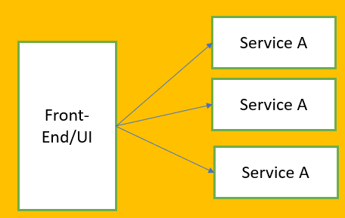
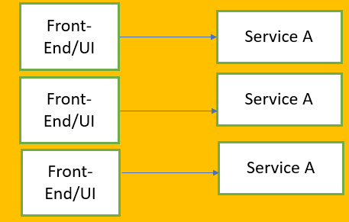
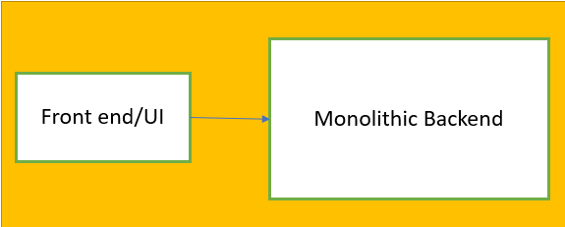
Evolution of UI with Microservices
Frontend also needed to change
Micro Front ends
Single Page Applications
React | Angular

Slide 211
What next??
Microserivces Integration patterns: Summary

Slide 212
Microservices Architecture
MICROSERVICES DESIGN PATTERNS
Microserivces Integration Patterns
Summary

Slide 213
Summary
API Gateway
Aggregator
Branch
Chained
Client side UI Composition

Slide 215
What next??
Microservices Observability Patterns:
Log Aggregation & Distributed Tracing

Slide 216
Microservices Architecture
MICROSERVICES DESIGN PATTERNS
Microservices Observability Patterns:
Log Aggregation & Distributed Tracing

Slide 217
What next??
Microservices Observability Patterns:
Performance Metrics & Health Check

Slide 218
Microservices Architecture
MICROSERVICES DESIGN PATTERNS
Microservices Observability Patterns:
Performance Metrics & Health Check

Slide 219
What next??
Microservices Observability Patterns:
Summary

Slide 220
Evolution of UI with Microservices
Service A
Front-End/UI
Service A
Frontend also needed to change
Micro Front ends
Single Page Applications
React | Angular
Service A
Front-End/UI
Service A
Front-End/UI
Service A
Front-End/UI
Service A

Slide 221
Microservices Architecture
MICROSERVICES DESIGN PATTERNS
Microservices Integration Patterns:
Aggregator

Slide 222
What next??
Microservices Integration Patterns:
Aggregator

Slide 223
Green learner

Slide 224
Microservices Architecture
Failing badly in microservices

Slide 225
Microservices Architecture
High Availability (HA)

Slide 226
Microservices Architecture
Fault Tolerance
Robustness
Circuit breaker

